Slide 1
Pay It Forward By Catherine Ryan Hyde
Summer Reading Extravaganza 2020

Slide 2
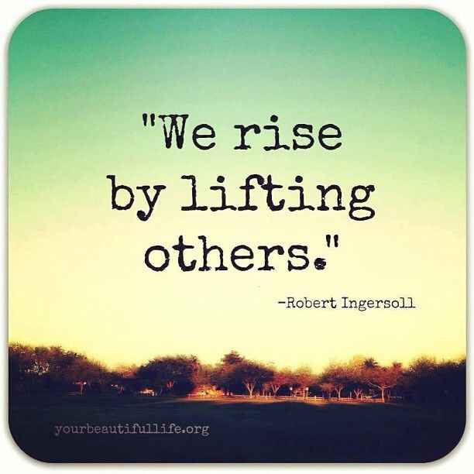
Pay It Forward Videos
https://www.youtube.com/watch?v=P4mSkTzxIb8
http://atalefortwoschools6.weebly.com/literacy-launch.html

Slide 3
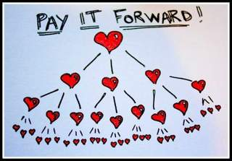
Teacher and StuDent Skit
Meet Mr. St. Clair, Trevor, and some students from Trevor’s class from the book Pay It Forward.
Task: Click on the link to see a live version of the skit that was performed in 2017. http://atalefortwoschools6.weebly.com/literacy-launch.html
Think of an idea for world change and put it into action.

Slide 4
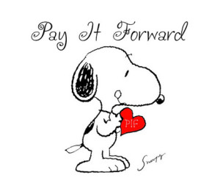
Why Do We Have A Summer Reading Extravaganza?
To promote literacy in the Levittown community
To build a community of learners
To give students and faculty a shared reading experience
To utilize the themes in the novel to discuss social and emotional learning
To engage students in interdisciplinary lessons and activities across disciplines
To encourage students to use the public library over the summer months
To provide book talk discussions throughout the summer to inspire readers of all levels
To excite and ignite students and faculty

Slide 5
Logo for The Extravaganza
For use on documents, website,
public library displays, etc.

Slide 6
A web links page Has Been created and will be kept dynamic throughout the summer.
Links on Salk and Wisdom homepage (with logo button) will link to a common page for Summer Reading.
Find a list of suggested books for those that are finished with the book and want to read more! (This is an advanced-reader accommodation.)

Slide 7
Interactive Website
http://atalefortwoschools6.weebly.com/

Slide 8
More on the dynamic web page…
Video clips
A moderated comments page with first names of students (blog)
Opportunities for students to be creative and upload photographs, pictures, writing pieces, etc. showing how they “Pay It Forward”
Link to author/book website for info and activities
Find e-book access to the summer reading book here http://atalefortwoschools6.weebly.com/ebook-access.html

Slide 9
Summer Support from Levittown Public Library’s Teen Librarians
Author displays and read-a-likes on the Levittown Public Library’s website
Visit www.levittownpl.org
Host 3 book discussion ZOOM meetings with Director of ELA, Kerin Slattery, and teachers from Wisdom and Salk to provide thoughtful questioning during summer months (July 22, August 12, August 25 from 7:00 PM to 8:00 PM)
Provide incentives for the YA readers (raffles)
Advertise the district’s Summer Reading Extravaganza in the summer newsletter
Advertise Book Discussion Zoom meets
Register students for Book Discussion ZOOM meetings
Offer Read Aloud Days for students via ZOOM meets
Offer workshops for parents via ZOOM meets

Slide 10
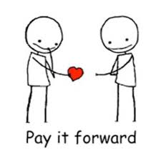
Question and Answer Spot
Where can I get a copy of Pay It Forward by Catherine Ryan Hyde??
Is it MANDATORY that I read this book??
How long do I have to read this book??
Do I have to write a report or some other book project??
Will there be activities and events concerning this book over the summer??
What will be on the website?
Will there be a Summer Extravaganza celebration??

Slide 11
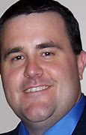
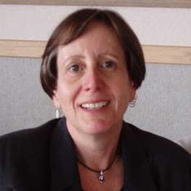
2020-2021 Visit from Mr. Richard Specht
Students who visit the Levittown School District’s summer reading website and/or the Levittown Public Library’s website throughout the summer months, can add their names to the virtual raffle box to win a special meeting with Mr. Richard Specht from the “Cultivating Kindness” program www.reesspechtlife.com
Dates To Be Determined
30 students from Salk and 30 students from Wisdom will be randomly selected from the virtual raffle boxes for a meet-and-greet experience with Mr. Specht and a special message from author, Catherine Ryan Hyde

Slide 12
Earn Raffle Tickets for Summer Reading!
Attend a ZOOM Book Discussion meeting on either July 22, August 12, or August 25 from 7:00-8:00 PM
Send in an image of artwork or writing on the Summer Reading website that you have created to show how you can “Pay It Forward!” (Make sure you scroll all the way to the bottom of the page. You don’t want to miss anything!) http://atalefortwoschools6.weebly.com/kindness-mosaic.html
Sign up for the Summer Reading Program at the Levittown Public Library and read! www.levittownpl.org
Participate in the blog found on the Summer Reading website http://atalefortwoschools6.weebly.com/blog
Visit the Levittown Public Library’s virtual library and check out a book from the Read-A-likes Display

Slide 13
R.E.A.D. Showcase
Reading Extravaganza Activity Demonstration showcase will be held in March of 2021 in the form of a video awards show entitled LIGHTS, CAMERA, KINDNESS!!
This awards show will highlight student-created videos showing how students “Pay It Forward” throughout the summer and into the fall of 2020
Community service projects can be incorporated
Find additional information about this on the Summer Reading website http://atalefortwoschools6.weebly.com/lights-camera-kindness.html

Slide 14
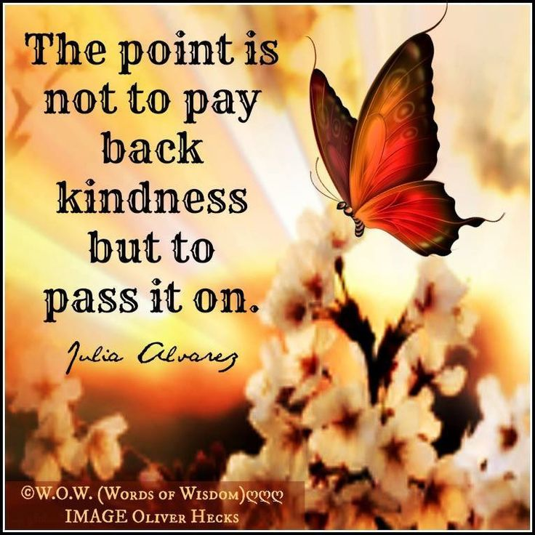
Have questions? Email Mrs. Slattery:
kslattery@levittownschools.com

